Slide 1
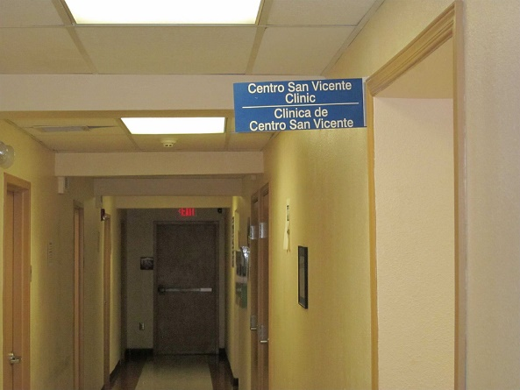
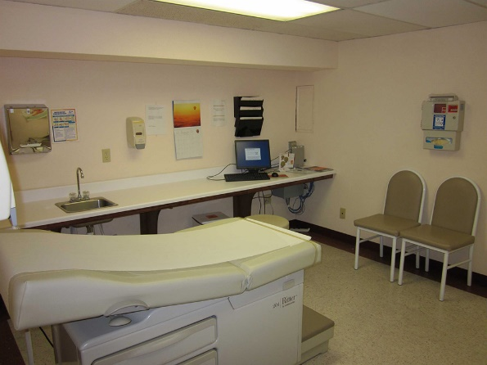
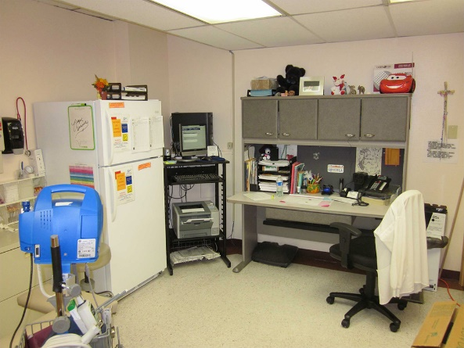
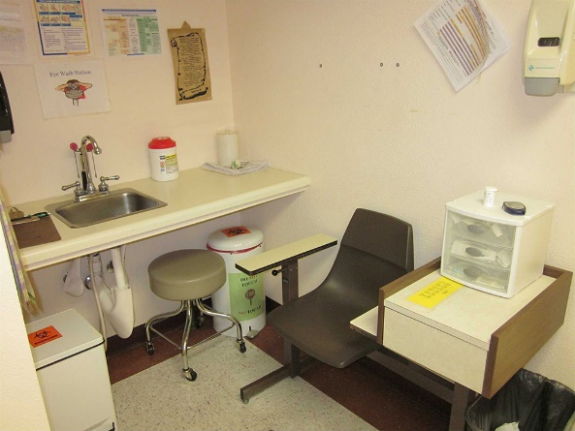
1208 Myrtle Ave El Paso, TX 79901
3rd floor
Ph: 915-351-8972
Fax: 915-351-6033

Slide 2
We are here!
CSV at Homeless is still available to address the healthcare needs of our homeless population.
Please call or email to connect us with your clients for COVID-19 screening. This will initially be done over the phone. Depending on signs and symptoms, clients will be given additional instructions.
Additionally, please contact us if your clients need assistance with managing their diabetes, hypertension, asthma, nicotine dependence, thyroid disorders and other acute and chronic conditions.

Slide 3
CSV at Homeless Staff:
For registration, please call or email Ana Trevizo, Patient Support Specialist: Ana.Trevizo@sanvicente.org
Certified Medical Assistants: Gloria.Sias@sanvicente.org; Maura.Rivas@sanvicente.org
Clinic Manager: Esther.Perez@sanvicente.org
Case Managers: Maria.Avina@sanvicente.org and Aida.Gonzalez@sanvicente.org
Nurse Practitioner: Emily.Rosales-Baca@sanvicente.org

Slide 4
Screening
CSV Providers will report to the El Paso Department of Public Health any patient that meets criteria for COVID-19 testing.
Any patient who calls (this is preferred) or comes by the clinic will be asked the following:
Do you have a cough, runny nose, shortness of breath, or fever?
Do you live in the same household or shelter as someone who has tested positive for COVID-19?
CSV staff will then proceed with Clinic Procedures as outlined by the Risk Management Team.

Slide 5
Screening:
We are screening clients over the phone.
We have a very limited number of tests.
The El Paso County leaders discussed opening drive-thru testing sites which will require an order from a healthcare provider for testing (age 65 and over with temp > 99.6 do not require lab order). We can discuss with each client or anyone assisting a homeless individual on how to receive that laboratory order if needed.

Slide 6
Telephone
We are requesting clients call first to be triaged. If patients present to the clinic with complaint of cough, runny nose, shortness of breath or fever, they will be provided with a mask if one is available. They will then be placed in a designated room for further evaluation.
Please allow homeless clients use of a phone at your facilities to call us to register if they are new to our clinic and to call us with any questions or concerns.
Established clients may request refills by telephone; our pharmacy remains open. Call us to coordinate pickup of medications for clients.
If shelter staff is working from home, please provide a room with a phone with our phone number posted for clients to call to have their healthcare needs addressed. Please also post the number for the COVID-19 Hotline 915-212-6843. See “Resources” slides.

Slide 7
For your consideration:
Provide soap and access to handwashing stations 24/7 whenever possible. Install soap dispensers and paper towels, if funding permits. Basic infection control measures must be prioritized.
Display important phone numbers and handwashing signs in English and Spanish throughout buildings and at your entrances.
Allow individuals to sit outside when possible in an effort to practice social distancing as much as possible. Space seating a minimum of 6ft apart when possible.
Waive fees for laundry and hygiene supplies if applicable.
Extend hours for showering and laundry.

Slide 8
For your consideration continued:
Develop relationships with UMC for recommendations on measures being implemented for social distancing.
Reach out to hotels for possible boarding assistance
Contact the Texas National Guard Assistance for tents outside of existing shelters for clients to sleep; medical tents may soon be provided for hospitals and clinics. Have shelter staff consider tents for sleeping.

Slide 9
“Stay At Work, Work Safe”
Please review the “Stay At Work, Work Safe” El Paso County order. http://www.epcounty.com/admin/covid19.htm
Here are some takeaways:
• A person that is homeless is exempt from this Order, however, such a person is strongly urged to obtain shelter.
Healthcare operations should not be interrupted, including the work of people who support healthcare operations and facilities (i.e. providers, janitors, suppliers, etc.). The Order does not mean to disrupt healthcare operations in any way.

Slide 10
Resources
National Alliance on Mental Illness www.nami.org NAMI Helpline: 800-950-6264
SAMHSA Disaster Distress Helpline 800-985-5990 provides 24/7 counseling and support to people experiencing emotional distress related to natural or human caused disasters
WorkInTexas.com to search for and apply for over 500 available positions in El Paso. Ph# 887-2600
National Healthcare for the Homeless Council:
https://nhchc.org/clinical-practice/diseases-and-conditions/influenza/
www.ephealth.com
CDC interim guidance for homeless shelters:
https://www.cdc.gov/coronavirus/2019-ncov/community/homeless-shelters/plan-prepare-respond.html

Slide 11
Resources
El Paso County website http://www.epcounty.com/admin/covid19.htm
People experiencing unsheltered homelessness:
https://www.cdc.gov/coronavirus/2019-ncov/community/homeless-shelters/unsheltered-homelessness.html

Slide 12
Resources
Department of Public Health Hotline for COVID-19 questions:
(915) 212-6843
7am-8PM Monday-Friday
10am-6PM Saturday and Sunday
Translation available for 240 languages

Slide 13
UPDATES AS OF 3/31/20
Screening at shelters:
https://www.cdc.gov/coronavirus/2019-ncov/community/homeless-shelters/screening-clients-respiratory-infection-symptoms.html
Seniors 65 years of age and older:
http://epstrong.org/documents/covid19/health-orders/releases/2020.03.26%20NEWS%20RELEASE%20-%20COVID-19%20Drive%20Thru%20Specimen%20Collection%20Phase%20II%20Begins.pdf?1585677511

Slide 14
Centro San Vicente at Homeless
We are here. We can best serve our homeless population together!
QUESTIONS?

