Slide 1
El Paso HMIS Steering Committee Meeting “The More You Know”
January 2024
epchomeless.org

Slide 2
What Will Be Covered?
HMIS Help Desk Survey Results Including:
-Use of HMIS
-Difficulty of the Software
-HMIS Data Standards/HMIS Report Card
-Attendance of HMIS EOTF meeting
-Professionalism/Assistance
-Additional Comments

Slide 3
Use of HMIS on daily basis

Slide 4
Skill Level of HMIS

Slide 5
Difficulty of using HMIS

Slide 6
What feature would you like?
An auto exit notification that allows you to track your caseload when it's close to expire or a weeks notice would be great.
The ability to delete a service or correct them.
Ability to produce customized visualization related to programs.
A better Alert feature for upcoming annual assessments and reports due.
Hometown and future destination plans for clients.
Maybe a warning box on the head of household when data is missing.
Ability to place full client notes, and ability to retrieve them at any time. I believe, currently, that we can only retrieve notes during the current operating year.

Slide 7
2024 HMIS Data Standards

Slide 8
What we could have done better
Having a meeting with each agency
However, most said…
Training was perfect.
I felt prepared
They went over changes and gave us the opportunity to prepare.
The Eyes On The Fries meeting was very helpful. I was well prepared.
I think the power point trainings held by Denver and Gary are the best to prepare for changes, because they teach everyone all at once.
Notes:
Other comments about HMIS EOTF:
-Denver had the ability to give our issue his complete attention and we had the time go over the issue in depth.
-I enjoy the meetings with Denver, he teaching us new skills to improve our data. He answers, the concerns we have as a team and if he does not know the answer he will investigate and get back to us regarding the matter. Not only that but it helps us listen to other members and learn from them as well.

Slide 9
HMIS Report Card

Slide 10
Anything you would like to add?
Trends from month to month
Maybe CE outreach outlook or tally
One for our GPD program separately if possible
Other reports you would like to see..
Reports for our Agency:
-QTR & YTD reports
-PHIX
-Shelter Availability

Slide 11
Attendance of HMIS ETOF meeting

Slide 12
What did you like about it?
Its so nice having the meeting on Zoom so you don't have to travel anywhere. I really like the information and training materials.
Very informative.
It is very open to dialog and questions.
Our FAC loves them!
I am glad that we have the ability to ask and resolve issues which may, or may not be comparable between agencies.
What we need to change…
More timely notification of the meetings.
Notes:
Other comments about HMIS EOTF:
-Denver had the ability to give our issue his complete attention and we had the time go over the issue in depth.
-I enjoy the meetings with Denver, he teaching us new skills to improve our data. He answers, the concerns we have as a team and if he does not know the answer he will investigate and get back to us regarding the matter. Not only that but it helps us listen to other members and learn from them as well.

Slide 13
Benefits of the HMIS ETOF…
The HMIS EOTF lunch meeting is for HMIS users to be able to ask any questions about either their program setup, clients in their programs, learn something new or to resolve an issue they are not sure about.
Even if you don’t have a question, you can still learn from others who have similar questions.
I try to keep it around everyone’s lunch time. If you would like it at a different time, please let me know and we can try to accommodate.
Remember, this meeting is for you! Take advantage of these meetings as much as you can!

Slide 14
Professionalism & Assistance

Slide 15
Professionalism & Assistance

Slide 16
How Can We Be Better???
At times, we are either out of the office or busy with other HMIS users. You can always leave us a voicemail or send us an email and we will reach out to you with an answer.
When it comes to help desk tickets to Bitfocus, sometimes they can take a day or two to solve or complete. Remember, we will always send updates when we receive them. You can always call or email to ask about the status of the ticket at any time.
We may sound like we are questioning you, but it may be due to not understanding your question. If we ever sound rude or unprofessional, please let us know or contact the EPCH Director.
If you want any 1 on 1 or group training, please let us know. We want to make sure everyone is on the same page.

Slide 17
Additional Comments
Staff are friendly, welcoming, and diligent in the work they do.
Thank You, for always assisting me with my questions, and for being professional!
I am extremely grateful for all he help Denver gives me every time I call. Thank you for guiding me with reports and questions I may have.
I appreciate, Gary and Denver's patience as there are a few individuals who are new to understanding the HMIS system.
Outstanding Team of Professionals everyday and anytime you call them.
Everyone I have had the pleasure of working with from the coalition, have been so helpful and helps with patience and detail.
Thank you all for the assistance provided. We appreciate you! Denver rocks!!
Great team, can't wait to see how 2024 goes!

Slide 18
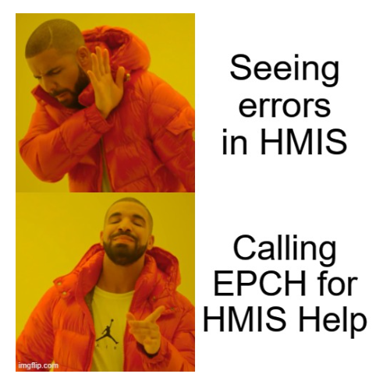
Thank you!
EPCH Contact Information:
-Gary Gray-HMIS Senior Administrator
ggray.epch@elp.twcbc.com
-Denver Herald- HMIS Support Technician
dherald.epch@elp.twcbc.com
-EPCH Phone Number (Office Hours: M-F 8am-5pm)
(915) 843-2170
WE ARE HERE TO HELP!

